Slide 1
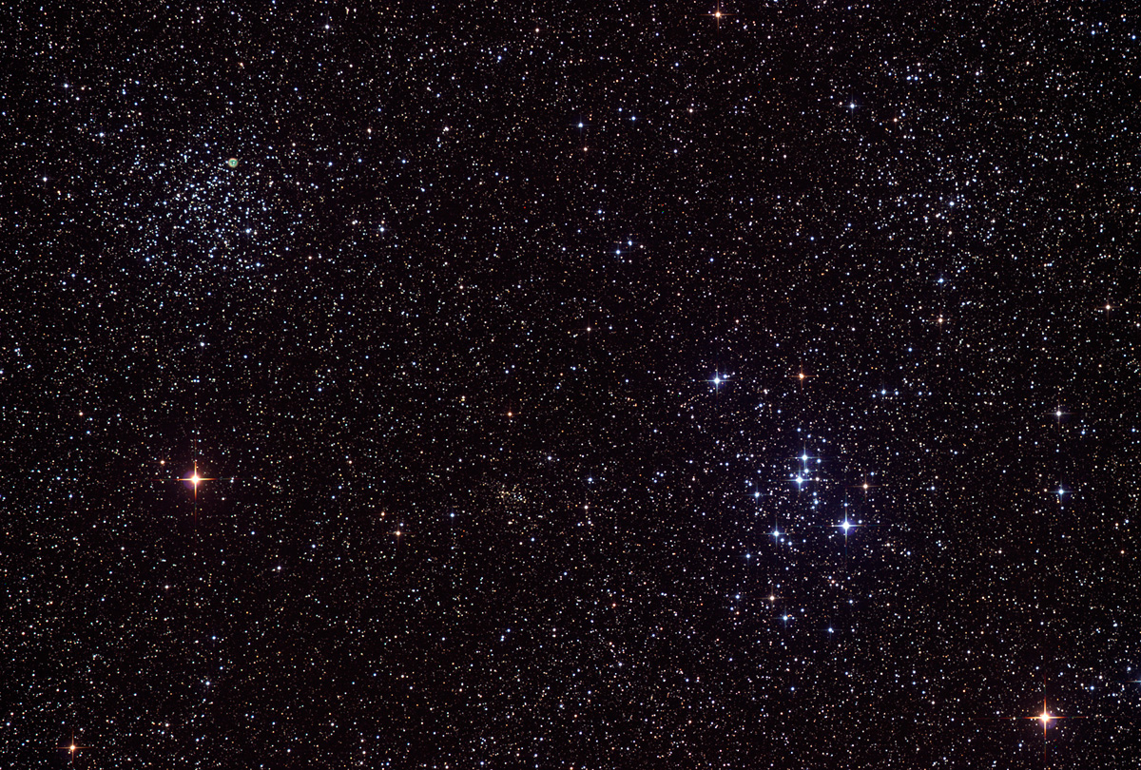
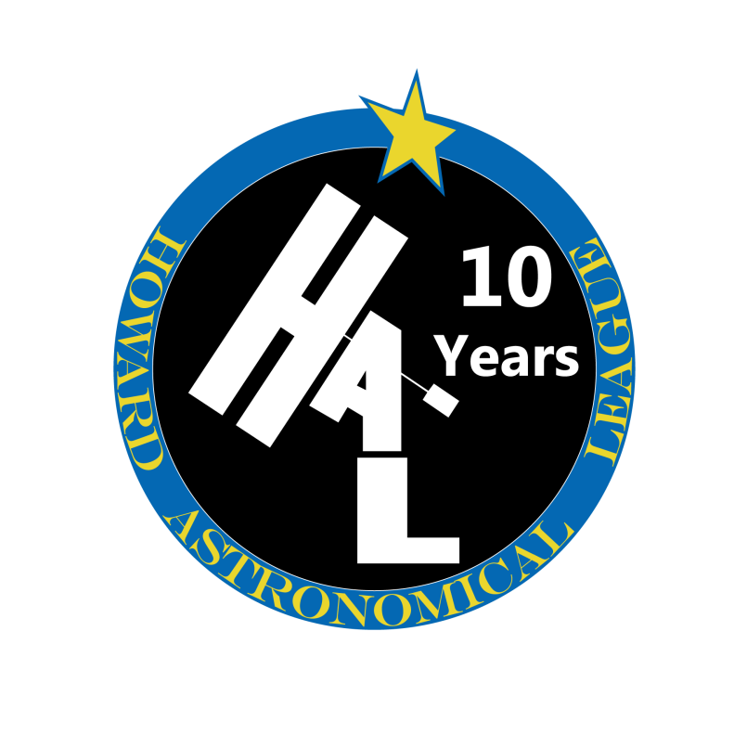
Howard
Astronomical
League
14
January 16th, 2014

Slide 2
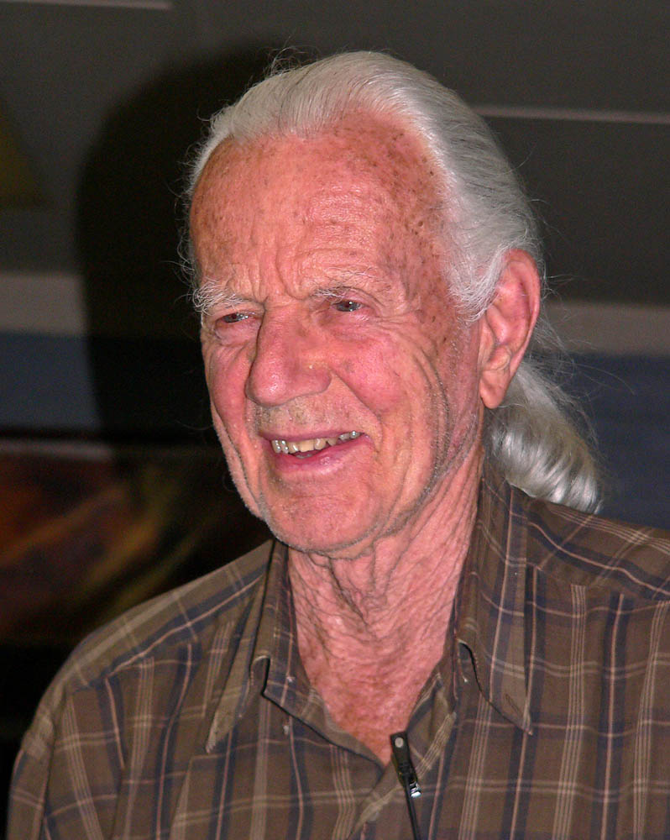
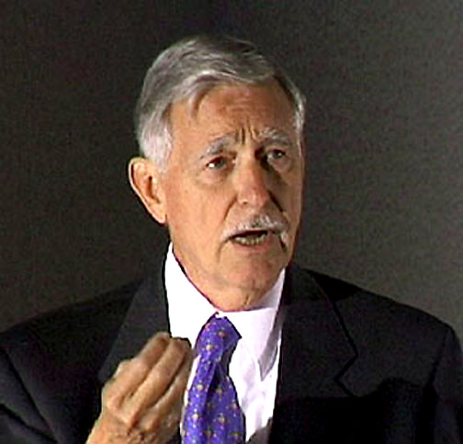
Passed Celestial Pioneers
John Dobson, 1915-2014
Halton “Chip” Arp, 1927-2013
Notes:
John Dobson died January 15, 2014 at the age of 98. Halton Arp died December 28th, 2013 at the age of 86.

Slide 3
Astronomical League Observing Club Awards

Slide 4
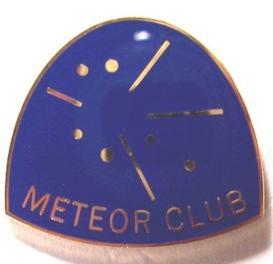
Chris Todd
Meteor Observers Club
Notes:
Note that I don’t get the Pin until I’ve observed for 36 hours.

Slide 5
Upcoming club activities

Slide 6
Star Parties and public outreach!
None until March.

Slide 7
Member’s astrophotos and sketches

Slide 8
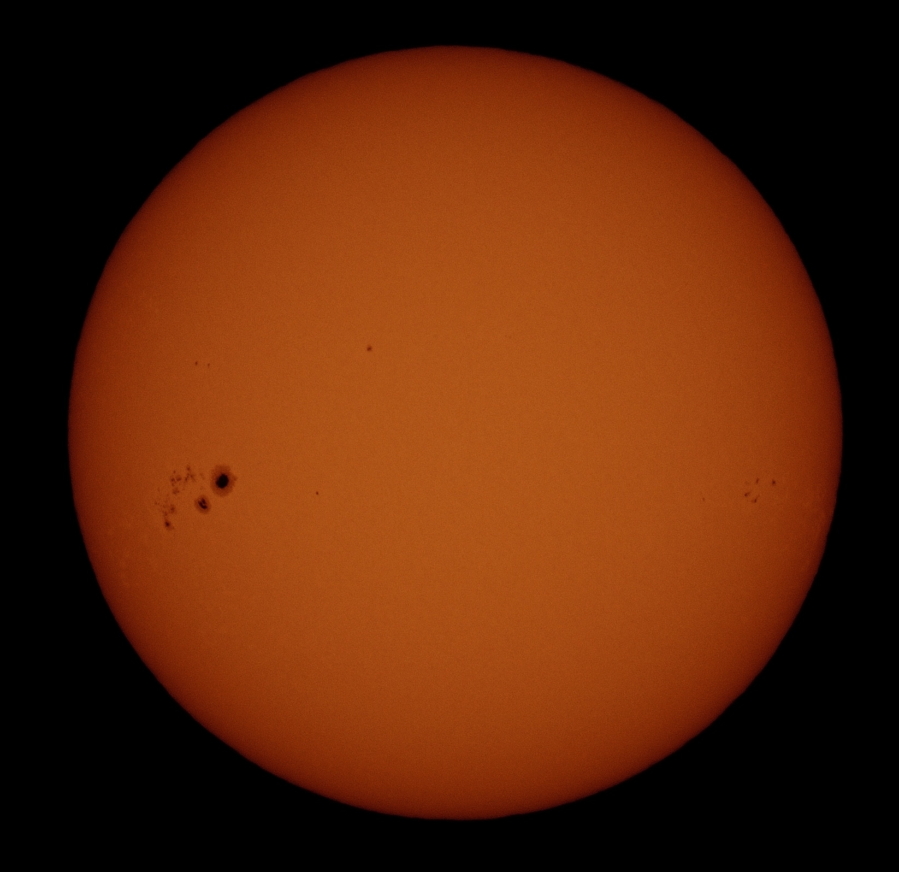
Richard Orr

Slide 9
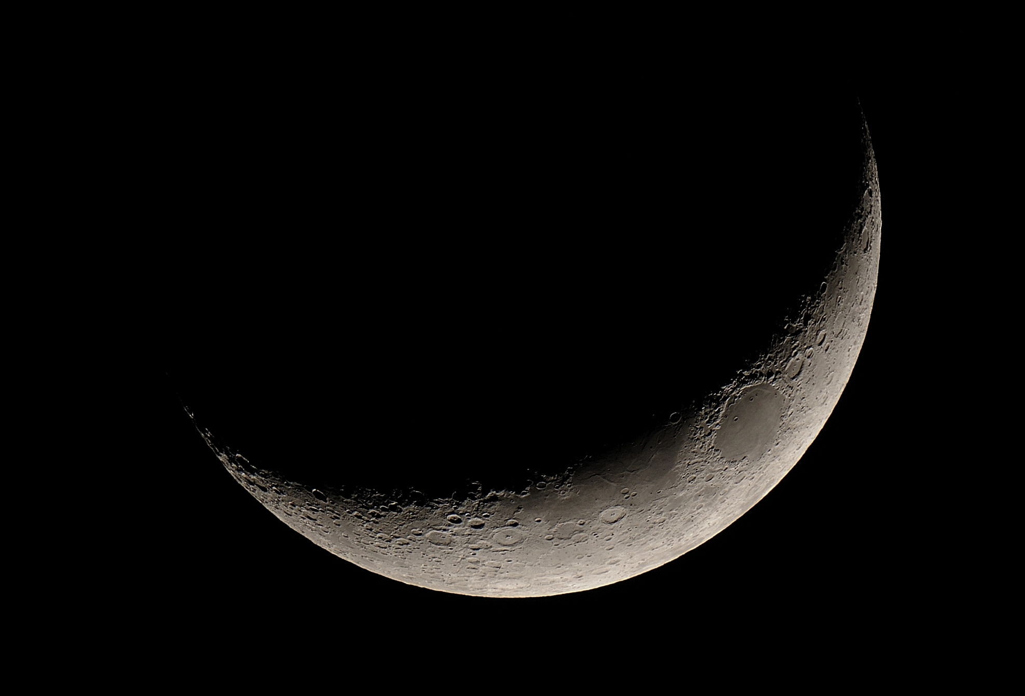
Richard Orr

Slide 10
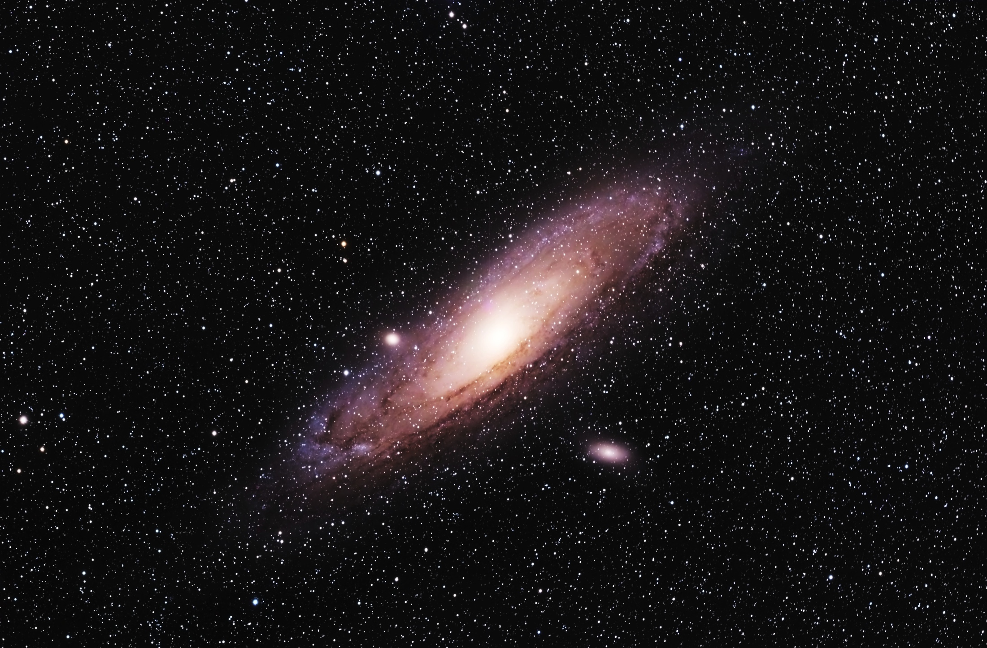
Victor Sanchez
Notes:
5 hours total, 2h lum, 1h each RGB, taken from New Mexico Skies with iTelescope.net T20, a Takahashi FSQ-106 with an SBIG STL-11000.

Slide 11
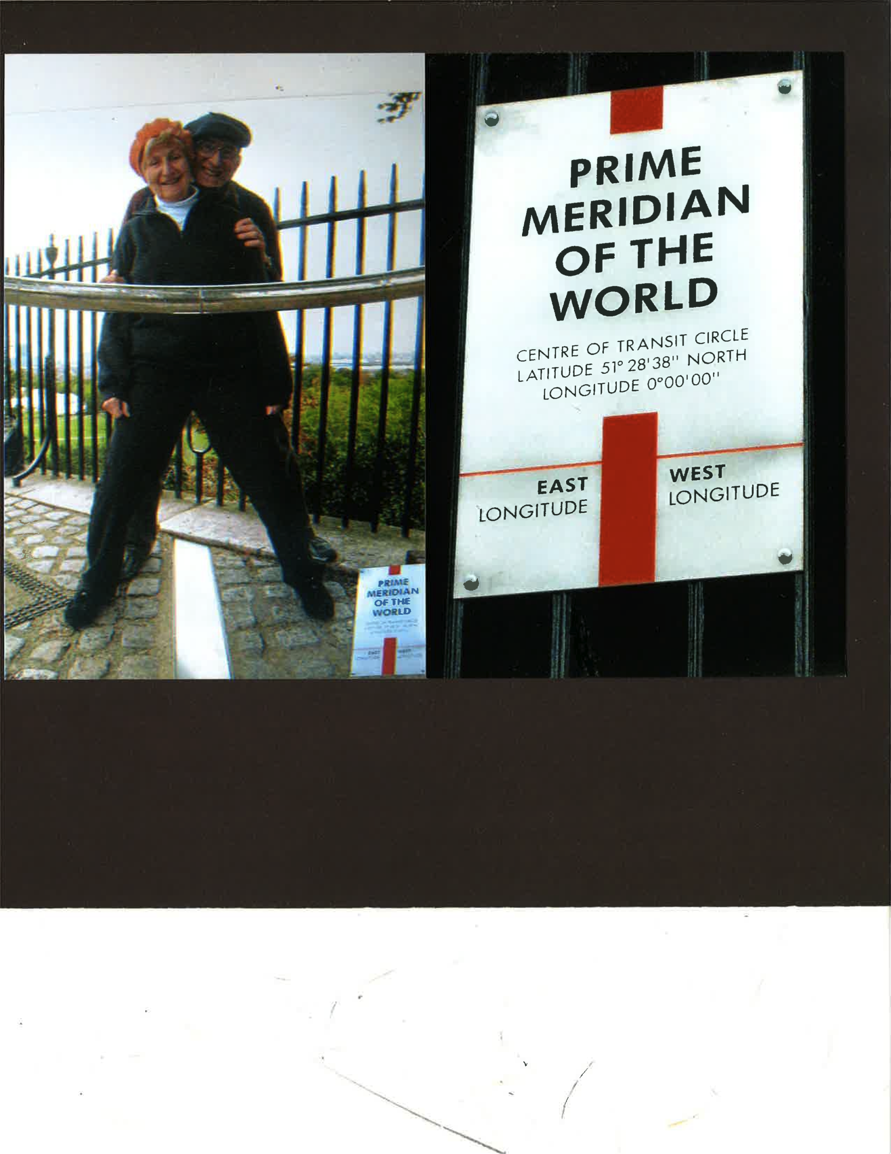
Herman Heyn

Slide 12
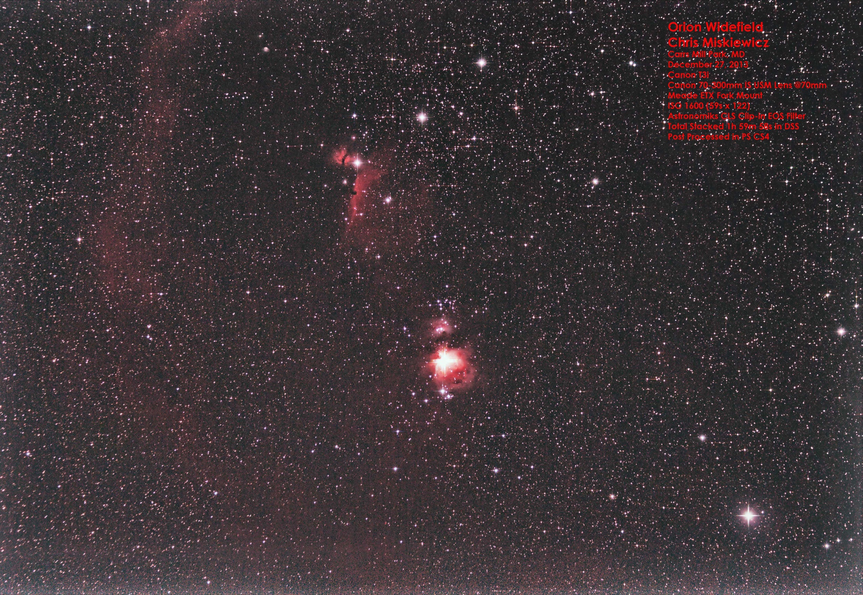
Chris Miskiewicz

Slide 13
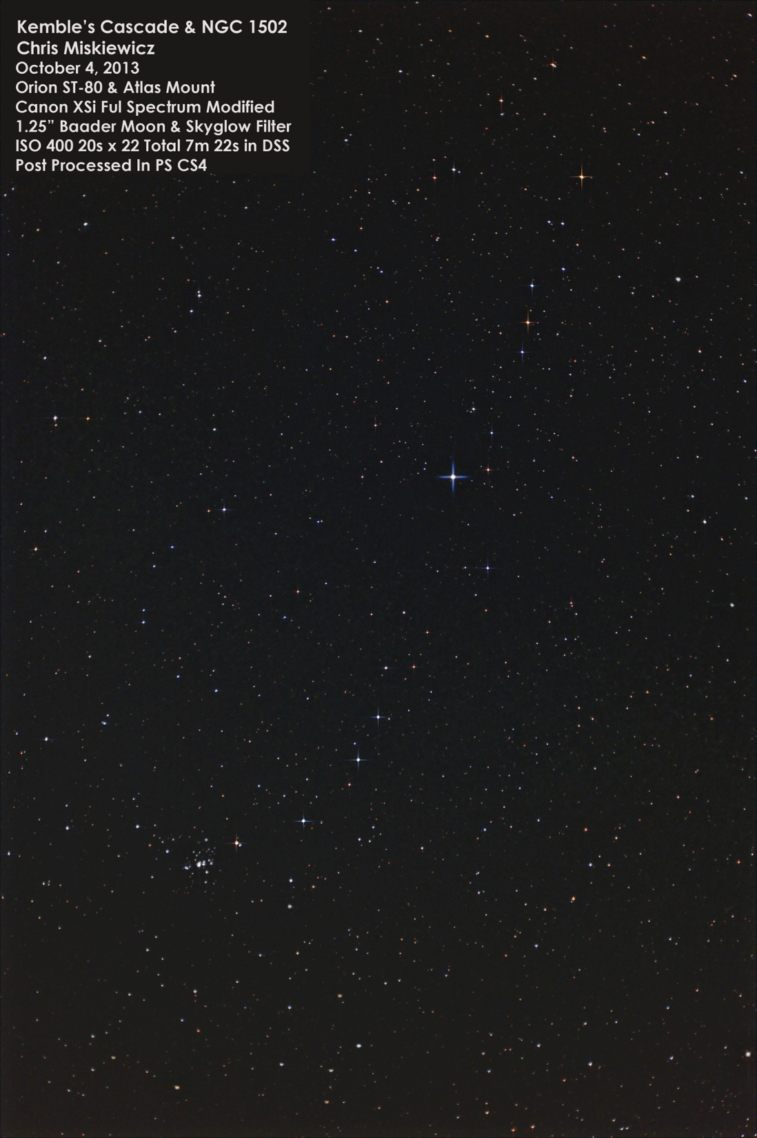
Chris Miskiewicz

Slide 14
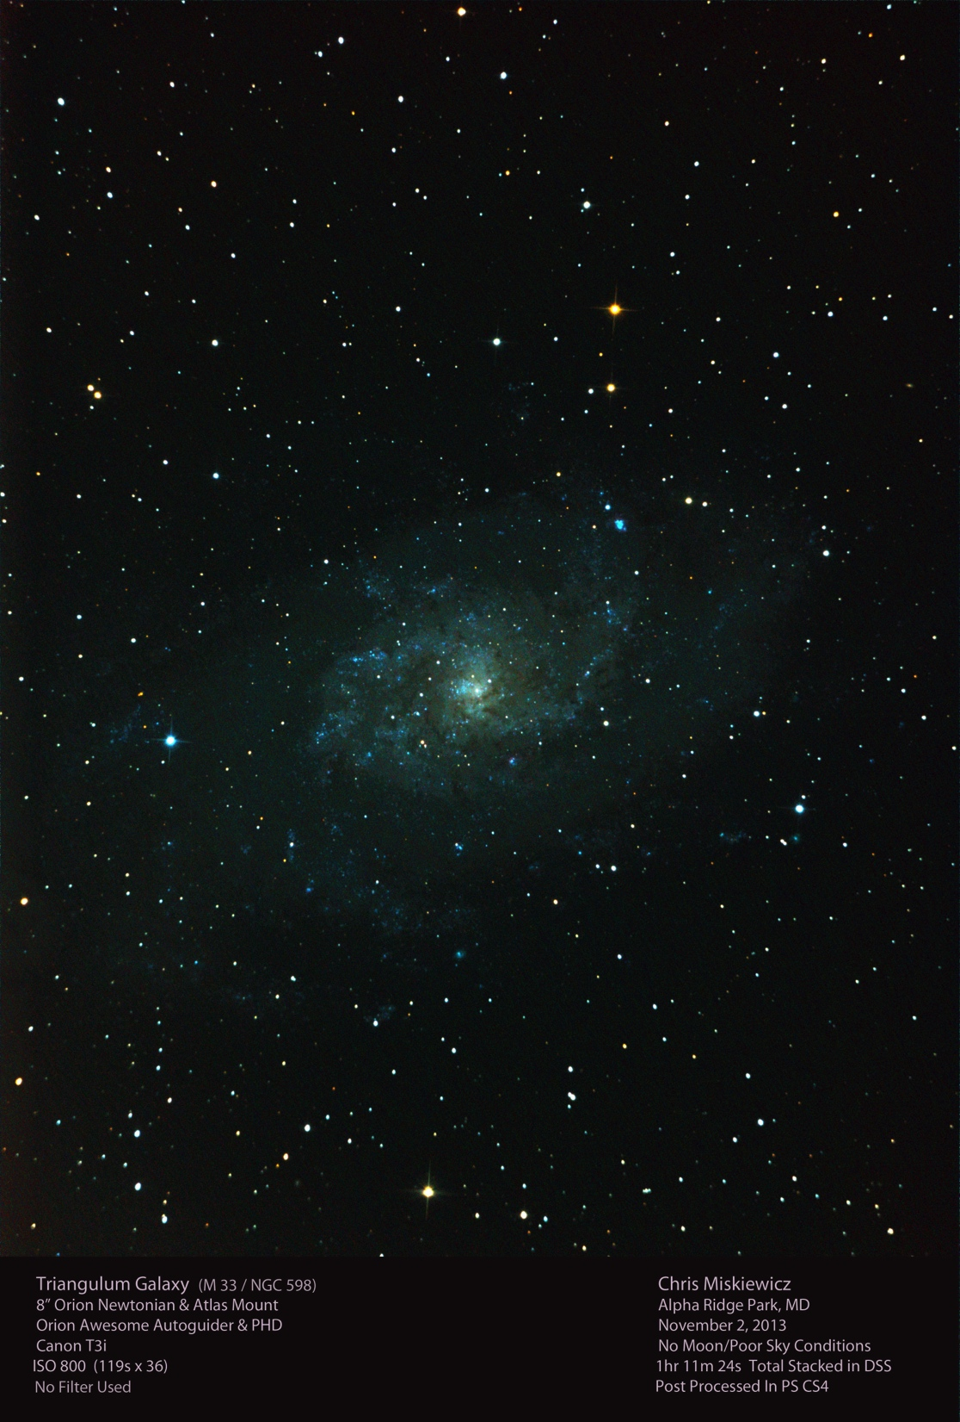
Chris Miskiewicz

Slide 15
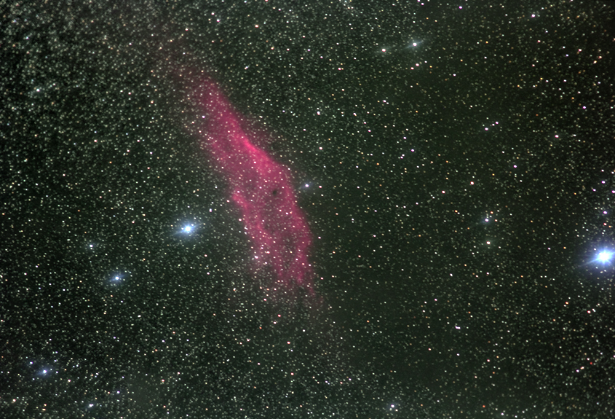
Joe Bohanon

Slide 16
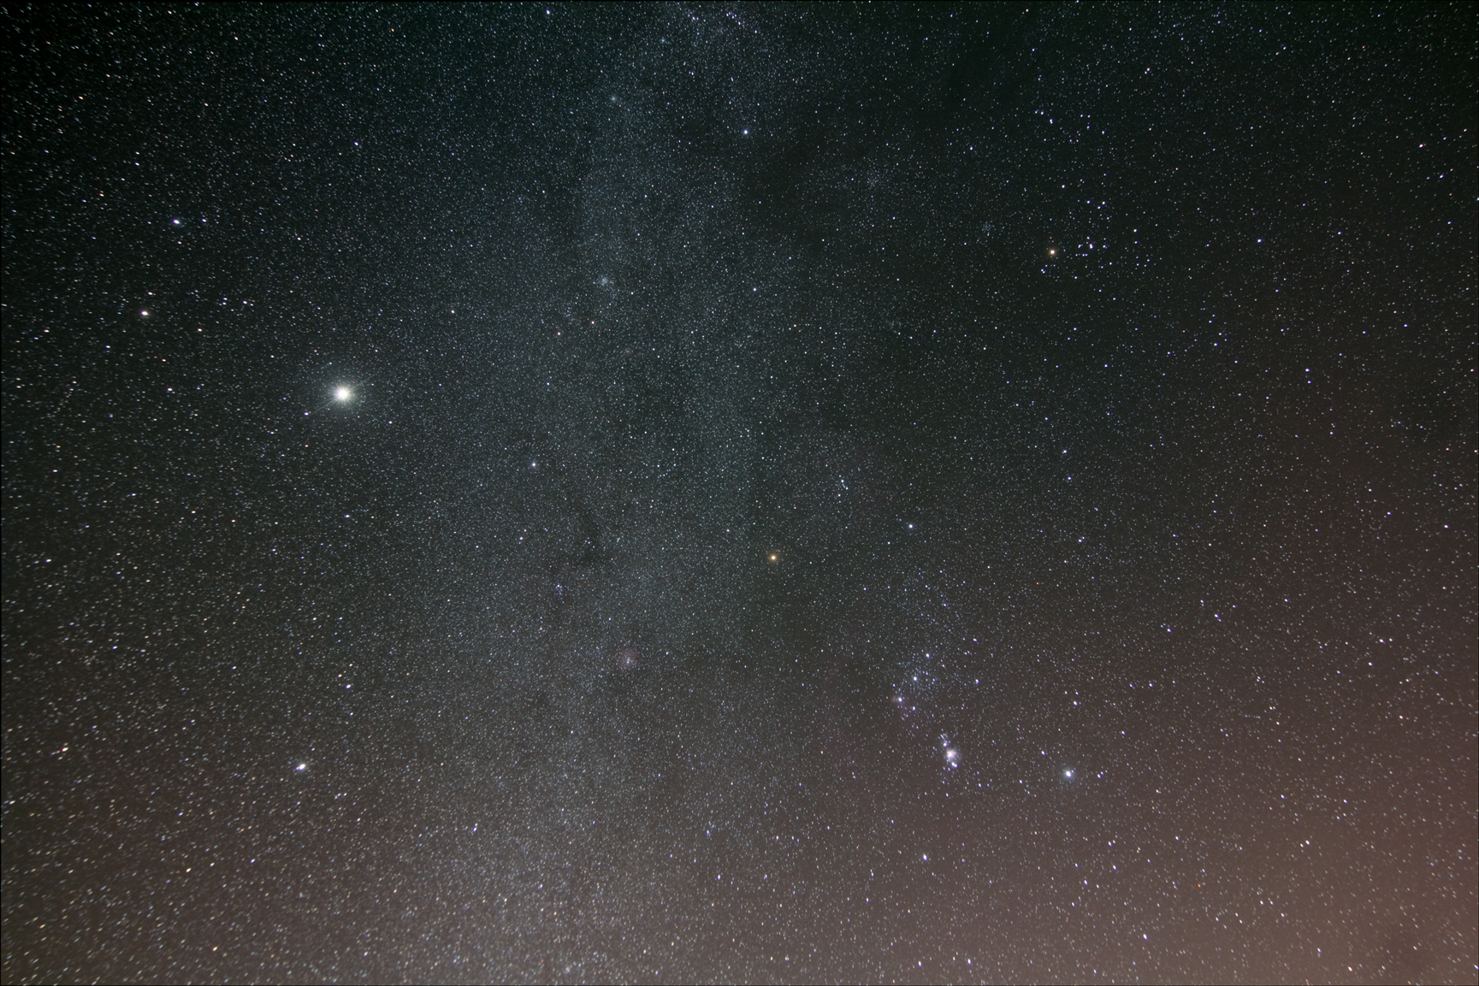
Joe Bohanon

Slide 17
Going Deep:
Stars in M31

Slide 18
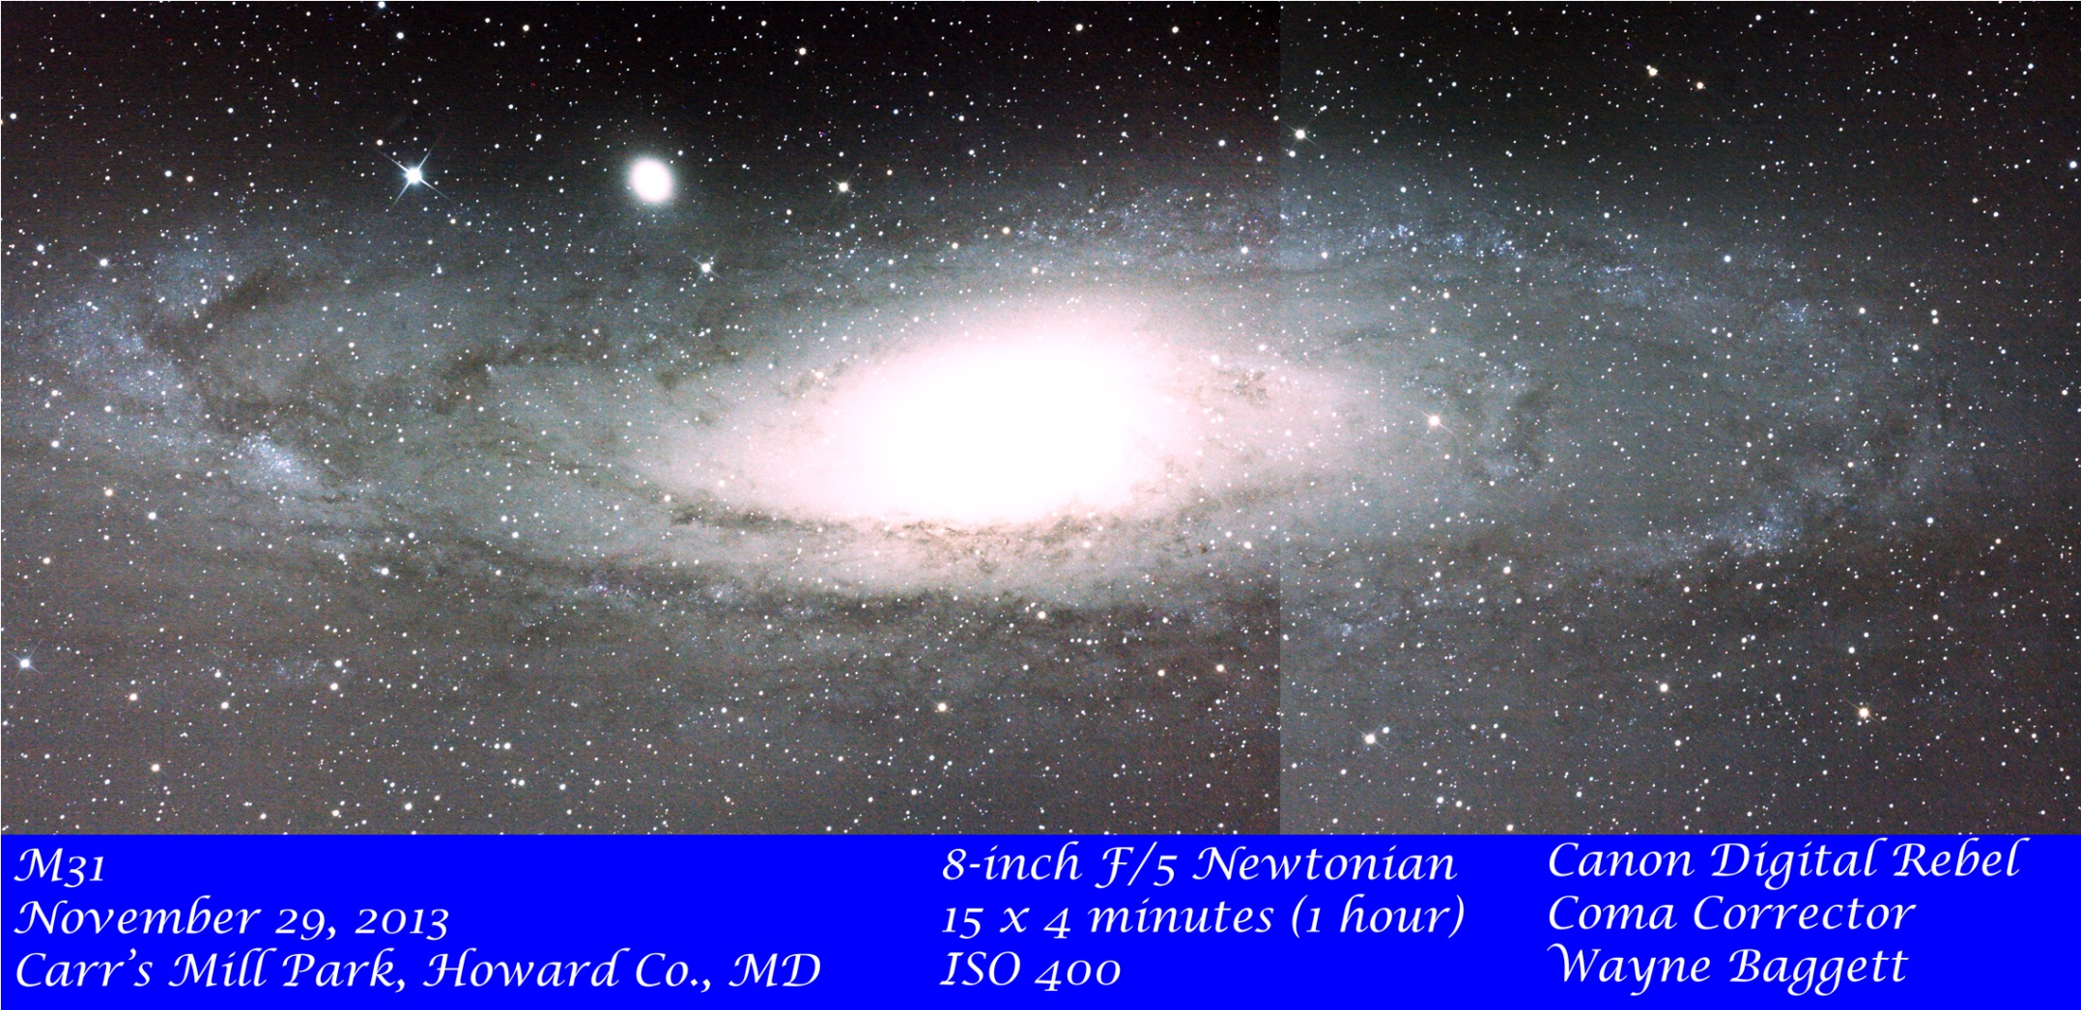
M31 Mosaic

Slide 19
Initial Assertion
Assertion: My M31 mosaic contains images of individual stars within the Andromeda galaxy itself.
This was questioned, so why did I make the statement?

Slide 20
Morphological Evidence
Faint blue stars are visible in regions with OB Associations in M31
Similar faint stars are missing from general field population

Slide 21
M31 Mosaic

Slide 22
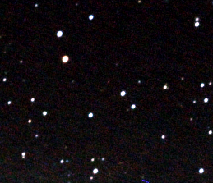
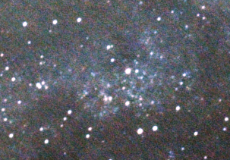
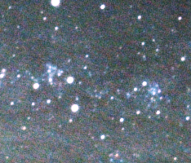
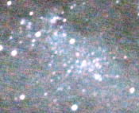
M31 Close Ups

Slide 23
Photometric Evidence
Previous observations showed I could reach V=13.5 easily in 45 seconds
M31 mosaic was 60 minutes = 80*45 seconds (~3*3*3*3) ➔ 4 mags deeper or 17.5 should be easy

Slide 24
Photometric Evidence
How bright are the brightest blue stars?
Look at an H-R diagram!

Slide 25
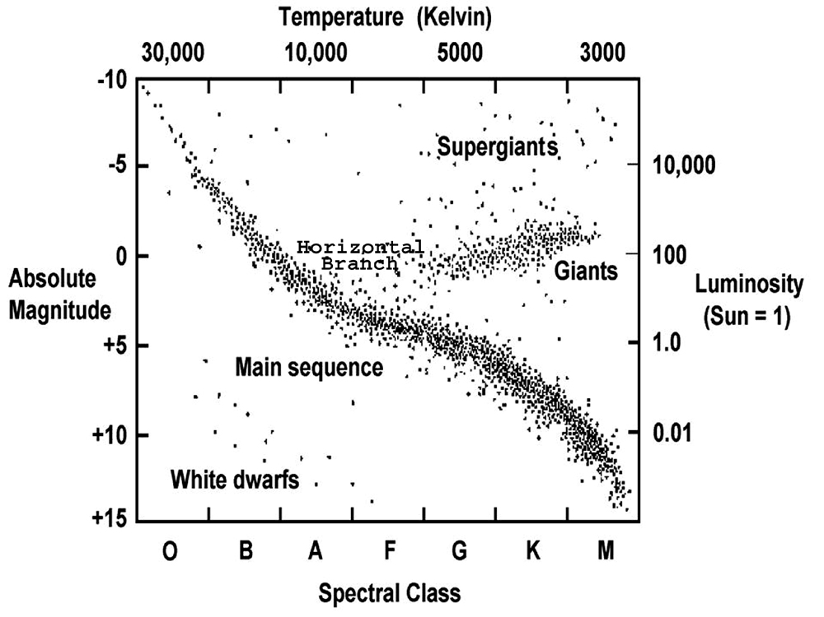
Photometric Evidence

Slide 26
Photometric Evidence
How bright are the brightest blue stars? M ~ -7.5
Distance Modulus Equation:
m – M = 5 log(d) – 5
For d=2.2x10⁶ly = 6.75x10⁵pc,
m = 16.7 ➔ Easy in an hour!

Slide 27
M31 Close Ups
Brightest blue stars in M31 should be easily visible in my mosaic!

Slide 28
HAL Treasurer’s report

Slide 29
HAL Treasurer’s Report
Income |  | Expenses
Individual memberships | $2,100 | PayPal fees | $107.79
Family memberships | $1,290 | Overpayment | $20.00
Contributions | $1,290 | Website renewal | $120.87
Key deposit | $50 | UPS Store renewal | $240.00
 |  | Key deposits refunded | $100.00
 |  | Astronomical League dues | $377.50
 |  | Insurance | $320.00
 |  | IDA Membership | $100.00
Total income | $4,730 | Total expenses | $1386.16

Slide 30
HAL Treasurer’s Report
Current account balances:
PayPal account: $714.67
Operating account: $5,740.53
Observatory fund: $14,487.63
Total monetary assets: $20,942.83

Slide 31
HAL Board Elections
Notes:
Have Mike Krauss and/or Bob Prokop run this slide

Slide 32
HAL Board Elections
Nominees:
President: Chris Todd
First Vice President: Wayne Baggett
Second Vice President: Chris Miskiewicz
Treasurer: Joel Goodman
Secretary: Josh Farquhar
Events Coordinator: Open
Notes:
Have Mike Krauss and/or Bob Prokop run this slide

Slide 33
What’s new for 2014?

Slide 34
More Speakers
Notes:
We had some great speakers in 2013, including Jerry Bonnell, Indy Kochte, Dr. Jason Kalirai, and Zolt Levay. This year, I’d like to have 6-8 guest speakers. If anyone knows of a potentially good candidate, please let me know.

Slide 35
Solar Max continues
Notes:
2013 was the best year for Solar observing in a long time, and 2014 started out with one of the best sunspot groups in years. Let’s hope it continues for a while longer.

Slide 36
More public outreach
Notes:
We will continue our partnership with the Robinson Nature center, as well as the HoCo public libraries, and we’ll have more opportunities for outreach because…
This all assumes we can actually get someone to volunteer to serve as Events Coordinator.

Slide 37
The observatory gets built!
(No, really, we mean it this time)
Notes:
I know, I said this last year, but we’re much more confident about it this year, for reasons that Joel will share with you. (Invite Joel up to share the big announcement).

Slide 38
HAL Observatory project and Watson Telescope

Slide 39
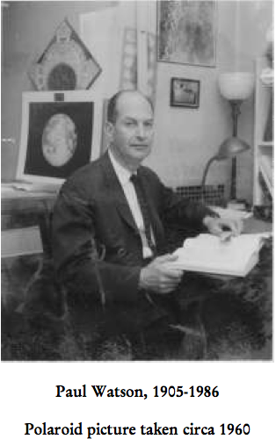
Notes:
Paul S. Watson was a well-known area astronomer, and former curator of Astronomy at the Maryland Academy of Sciences. He was also a former director of the Maryland Academy of Science’s Davis Planetarium. He also taught summer courses in astronomy at Morgan State and also at JHU. he gave planetarium lectures and devoted a significant amount of time each year to generating a graphic timetable of the heavens. Those used to be published in the December issues of Sky and Telescope.

Slide 40
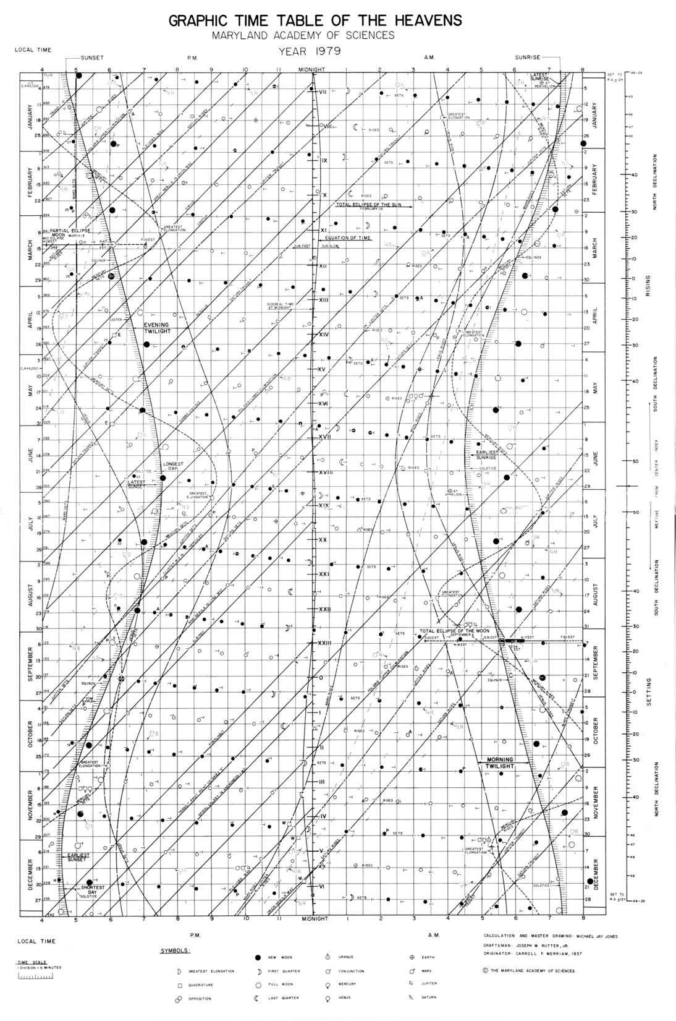
Notes:
devoted a significant amount of time each year to generating a graphic timetable of the heavens. Those used to be published in the December issues of Sky and Telescope. Shown here is the one from 1979.

Slide 41
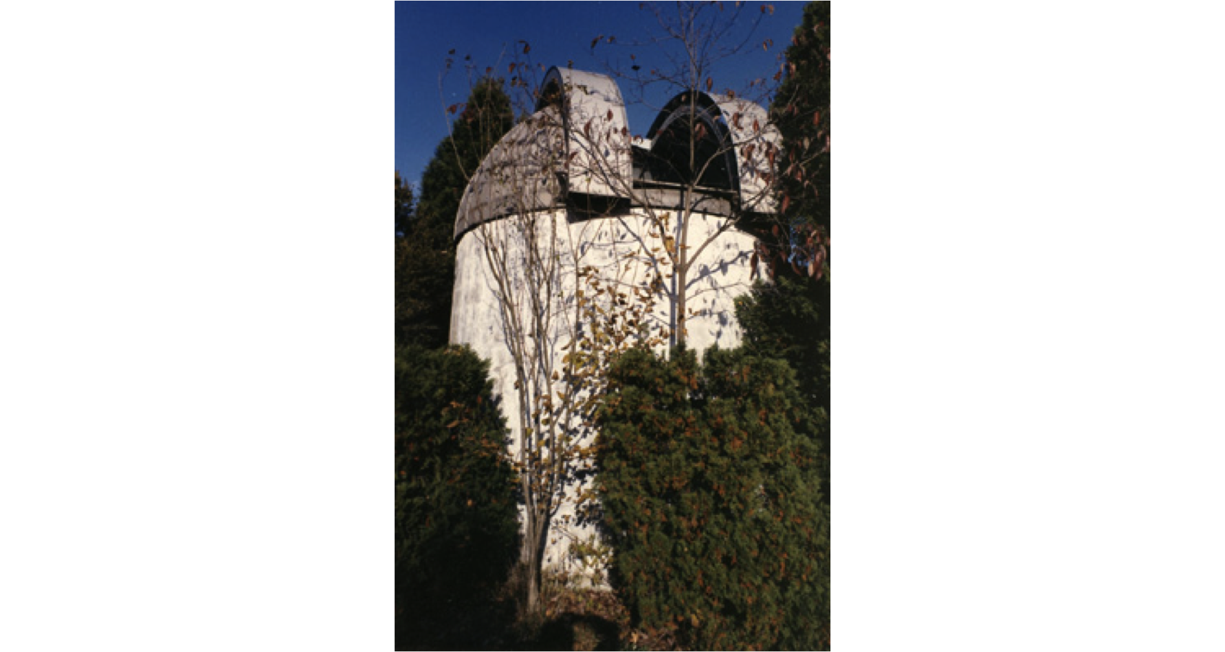
Watson Telescope
Some text here
Notes:
His observatory was on the Magothy River in Anne Arundel county, just off of Black Hole Creek.

Slide 42
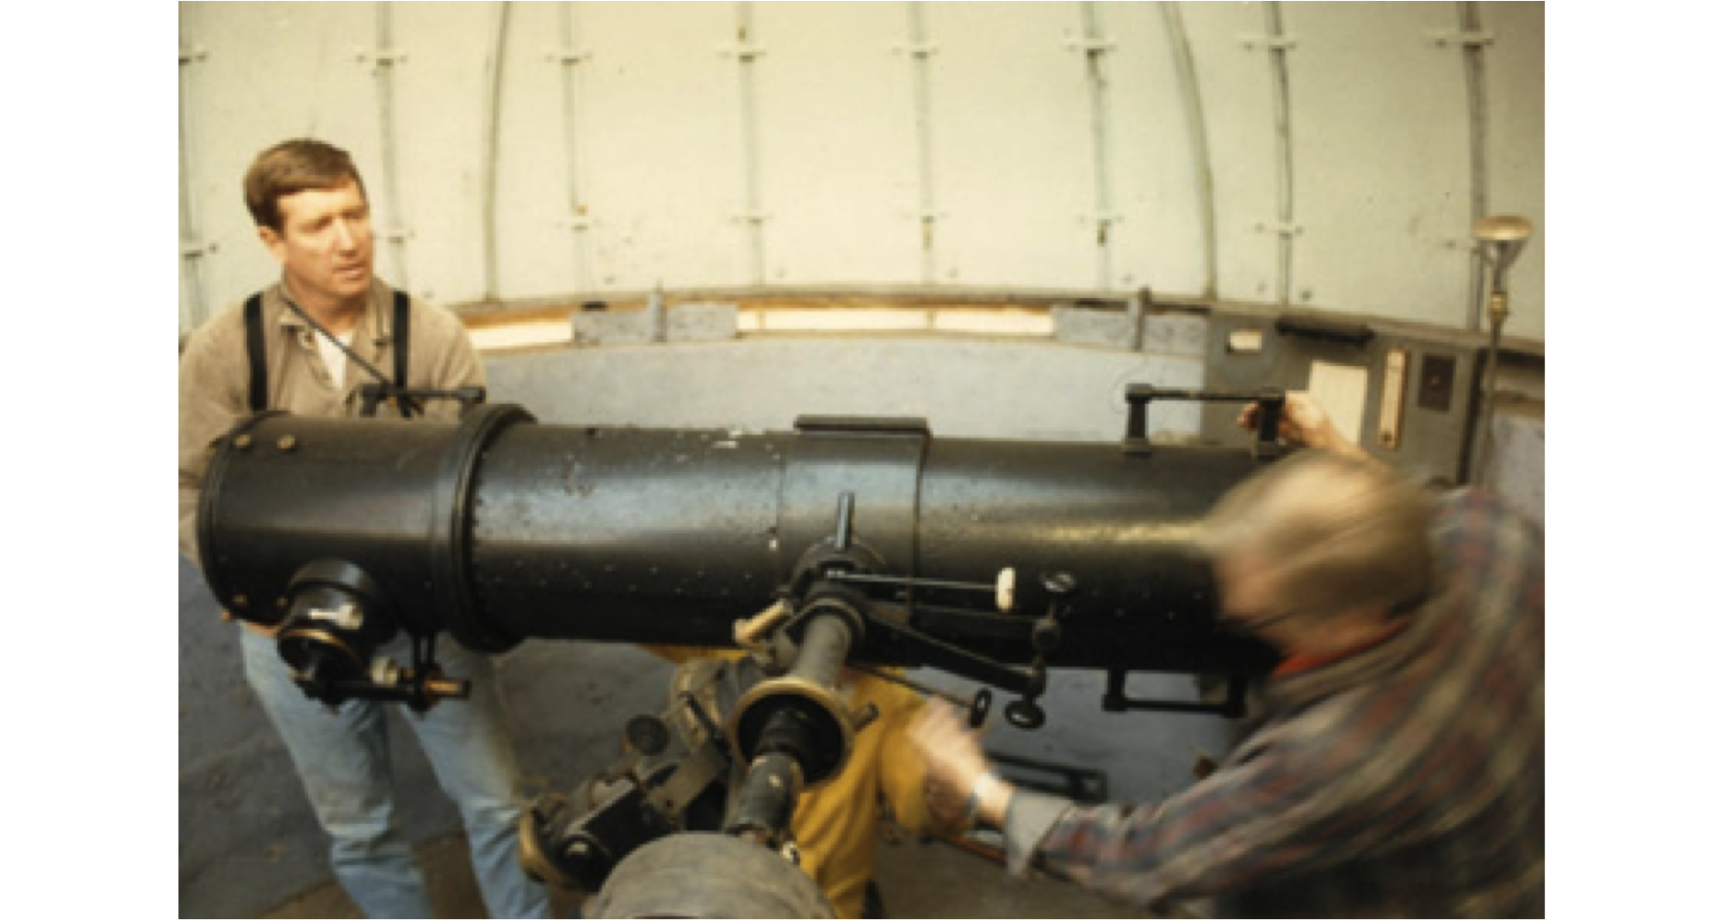
Watson Telescope
Some text here
Notes:
It is a 12” f/5.86 Newtonian reflector on a custom built equatorial mount. it was built by Joseph Woods, who owned a machine shop in Baltimore and fabricated the mounts, drives, tubes, etc. for two identical scopes. Woods kept one and Watson had one. For both of them I believe, they modified a silo dome with a slit to house the telescopes. The optics came from The Fecker Company in Pittsburgh.
Watson's telescope was in an observatory adjacent to his house on a bluff overlooking the Magothy River. (And the creek behind his house was Black Hole Creek!)
Woods' telescope was (and may still be) in his house in Northwood in Baltimore near where Memorial Stadium was (and close to the intersection of Argonne and Loch Raven). In the days when the skies there were still dark, he did astrophotography of nebulae and galaxies.

Slide 43
Watson Telescope
1986: Paul S. Watson dies
1988: BAS receives donation of Watson scope
1999: Restoration project stalls, Howard Astronomical League formed
2000-2013: HAL develops relationship with Howard County Dept. of Parks and Recreation
2014: Observatory construction begins
Notes:
The founding members of HAL were Dana Boltersdorf, Mike Hall, ZoAnn Lapinsky, Mary Kay Sigaty, and Malcom Willette. When HAL was formed, it received the Watson scope as well as $2,144 that had been raised to restore the scope, with the express purpose of restoring the scope and providing it with a new and permanent home.

Slide 44
Observatory Project
15 foot ProDome purchased
20 foot wide accessible building, with storage
Telescope restoration completed (including optical testing)
Marty Cohen from Company 7 refurbished and motorized the mount
Notes:
Tweak this text, and maybe include photos of the dome

Slide 45
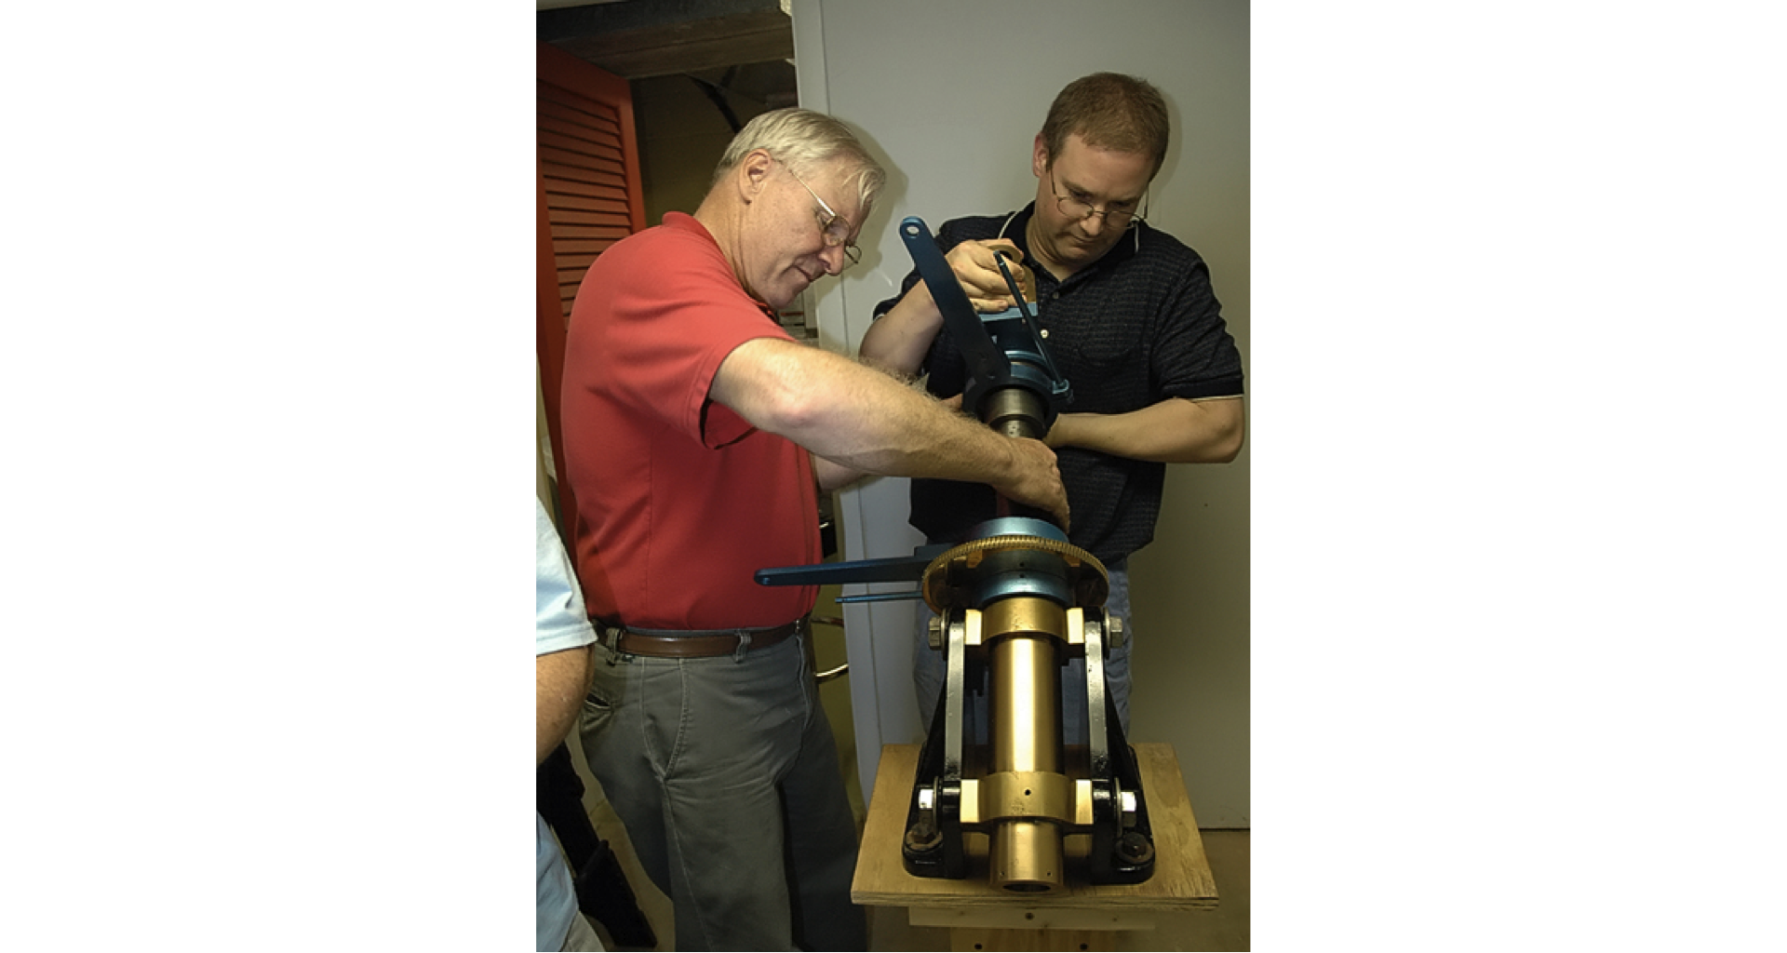
Observatory Project
Notes:
Marc and Malcolm reassembling the mount in Marc’s basement

Slide 46
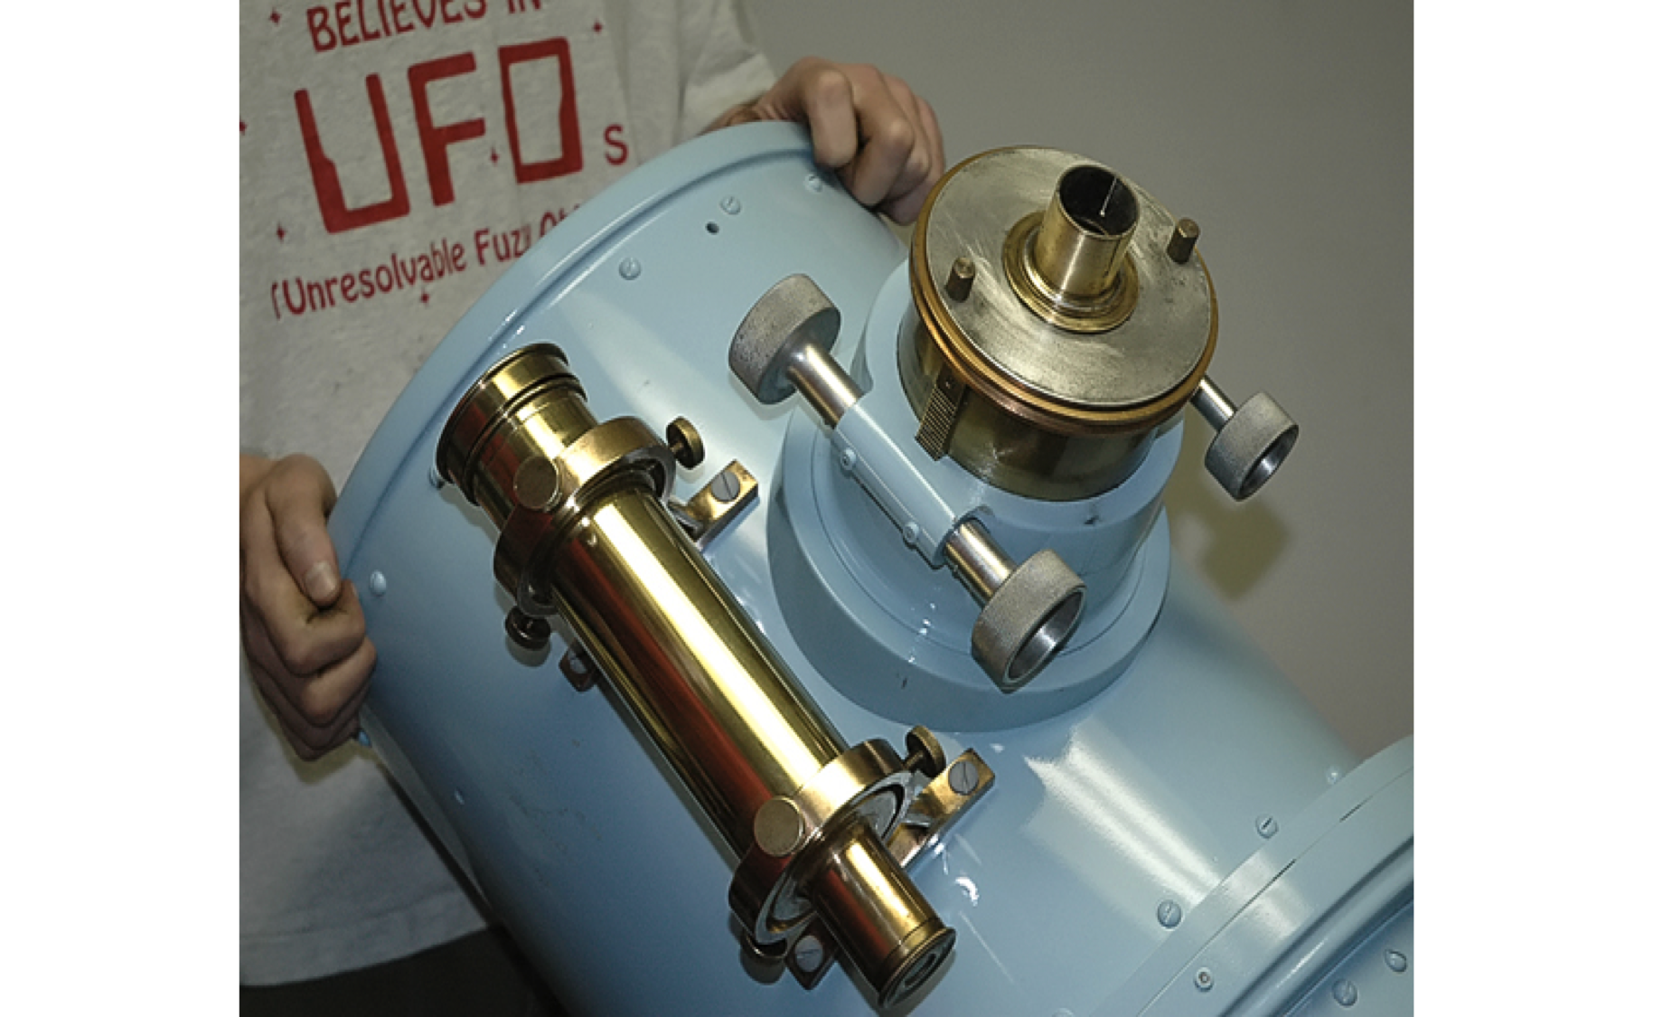
Observatory Project
Notes:
The focuser (4 inches!) and the finder scope

Slide 47
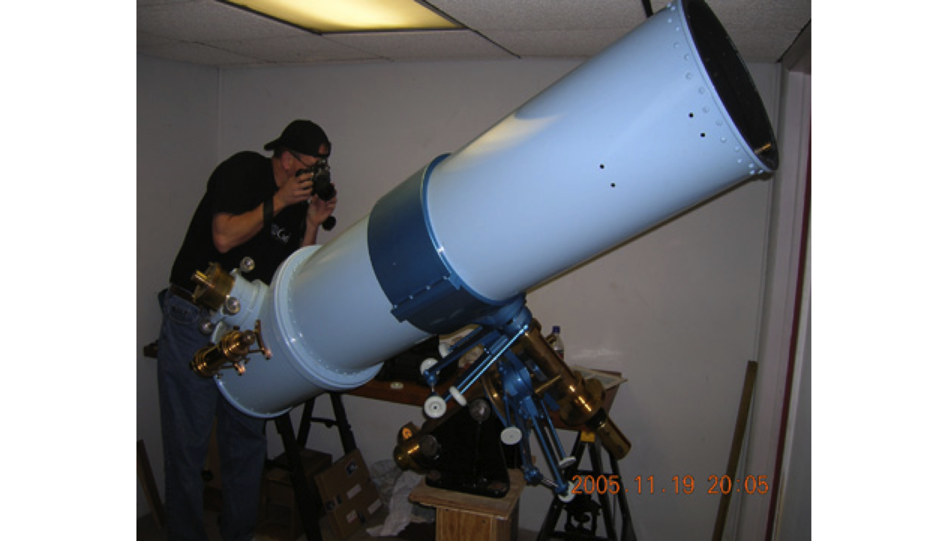
Observatory Project
Notes:
The scope mounted on the EQ mount, without the mirror or mirror cell, and pointed towards the ground.

Slide 48
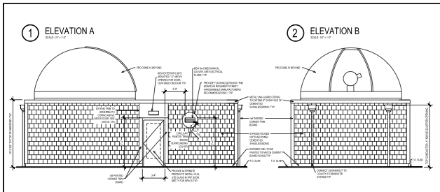
Observatory Project

Slide 49
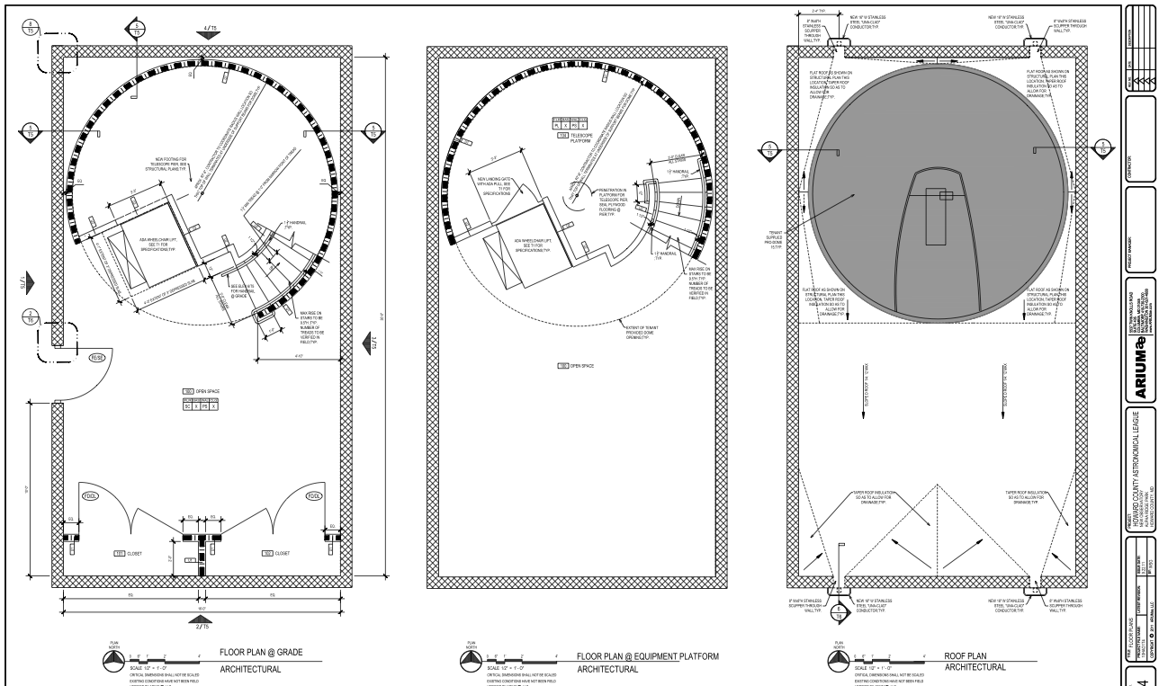
Observatory Project

Slide 50
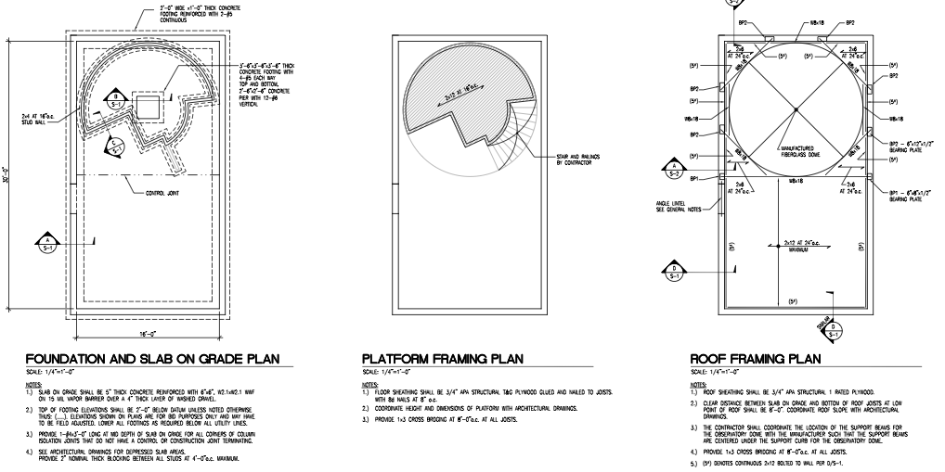
Observatory Project

Slide 51
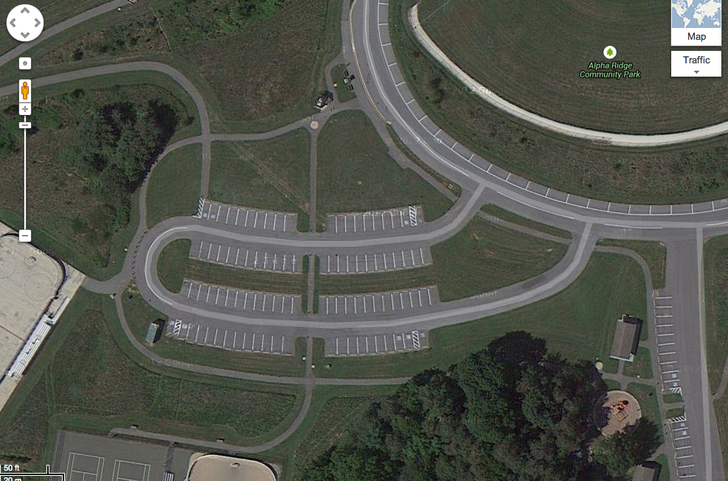
Observatory Project
Notes:
Include a picture of AR showing roughly where the observatory will be.

Slide 52
Thank You!
Next month’s meeting is on Thursday,
February 20th, 2014
7:30 PM
Meeting theme:
I don’t know yet

